Slide 1

EMPLOYEE RECOGNITIONS
October 2026

Slide 2


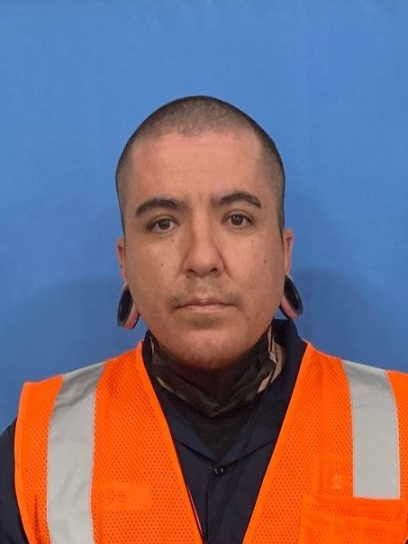
Roberto Navarro
Facility & Vehicle Cleaner
5-Year Service Award
Robert Navarro began his career with us on October 3, 2021, as a Facility & Vehicle Cleaner-Sanitizer. Since then, he has become an important part of our team and someone we can always count on.
Robert plays an important role in keeping our facility and demand response vehicles clean, safe, and well-maintained.
He consistently goes above and beyond what is expected of him. Robert approaches his work with pride and takes satisfaction in knowing that what he does contributes to the success of our team.
Robert is eager to learn and grow. He appreciates opportunities to participate in training and is always willing to learn something new.
Outside of work, Robert enjoys spending time with his family.
One of his favorite activities is painting with his daughter, creating special memories together and enjoying time as a family.
Thank You, Robert, for Your Service!

Slide 3
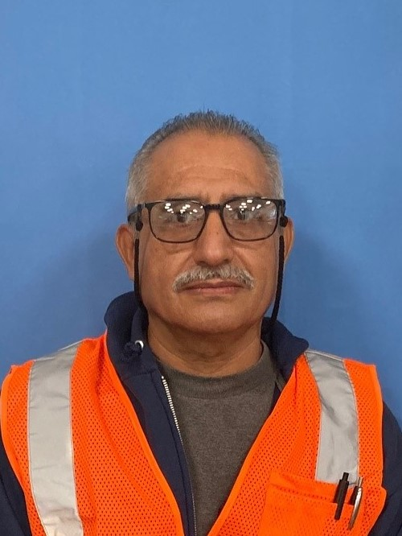
Honorio Navarro
Service Worker I
5-Year Service Award
Congratulations to Honorio on reaching 5 years of dedicated service with GCTD! Your hard work, commitment, and reliability help keep our fleet moving.
Honorio always brings a positive attitude to work. Not known for his words, but more his actions, he leads by example. He is a true team player, always willing to step in and do whatever is needed.
We’re glad to have Honorio as part of our maintenance team!
We appreciate your years of service and look forward to many more years of collaboration.
Thank You, Honorio, for Your Service!

