Slide 1
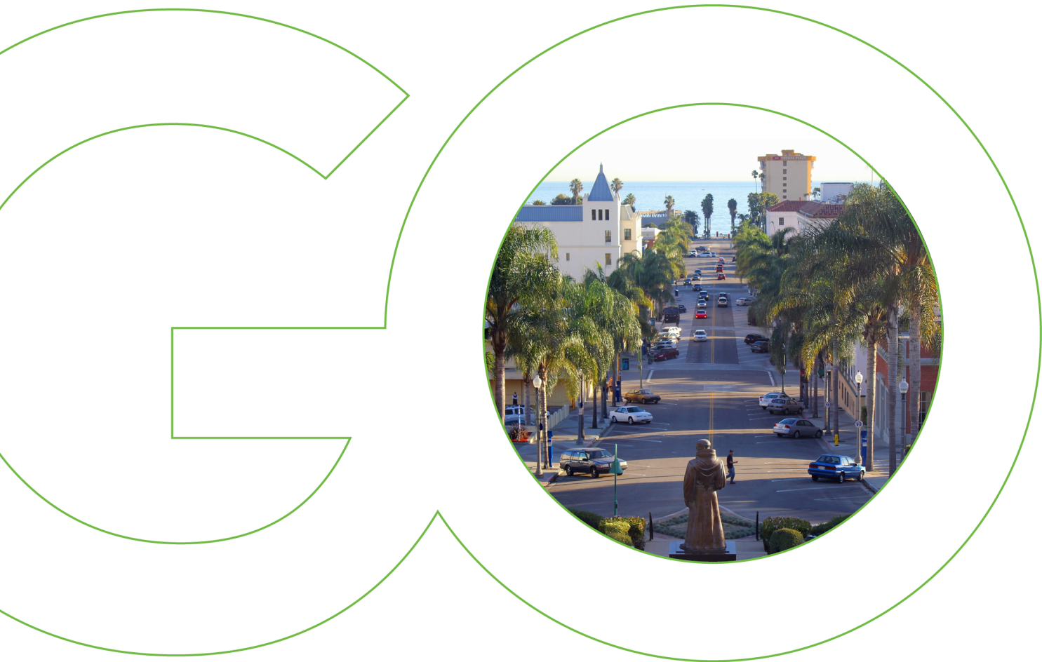
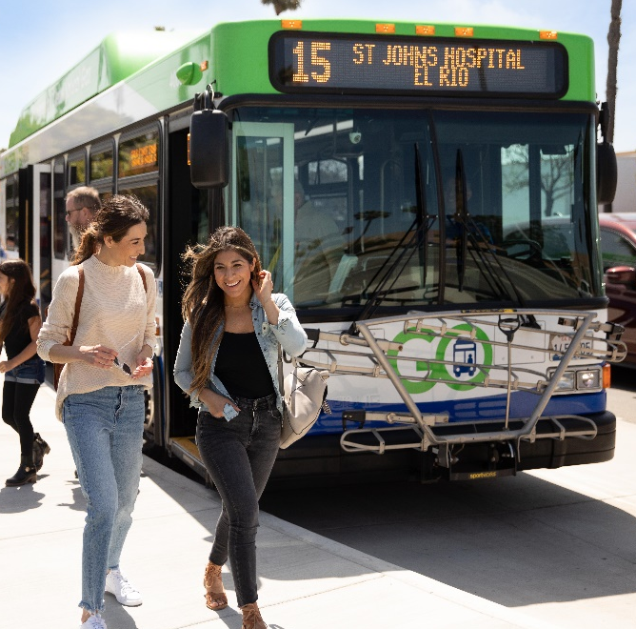
Employee recognitions January 2022

Slide 2
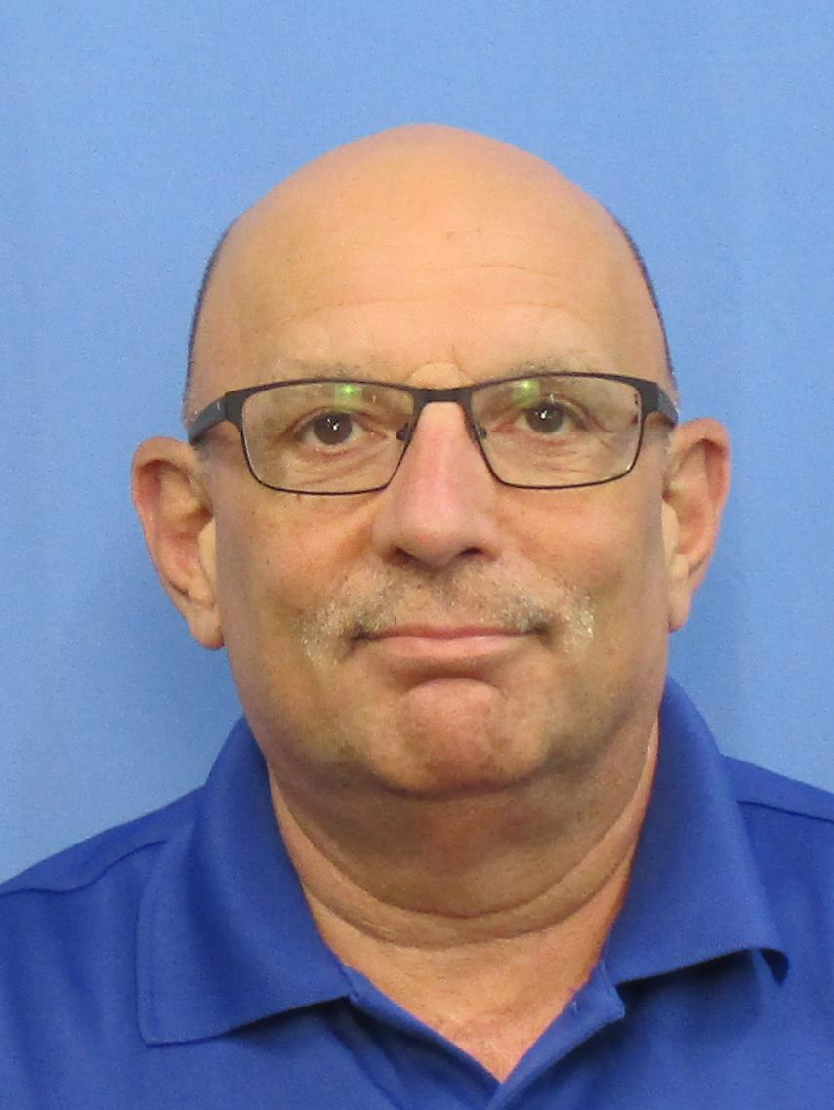
Louis Annino,
Bus Operator
10 Years Service Award
Louis has been a bus operator since January 30, 2012.
Louis enjoys bike riding and having a homemade dinner with his family prepared by his wife, Mary Ann. What he enjoys the most is spending time with his three grandsons, Jacob, Conner, and Jesse. They are the joy of his day.
He stated: “Being with my coworkers at Gold Coast Transit has been a great experience. I look forward to seeing them in our break room before getting the day started.”
Mr. Annino would like to thank everyone at Gold Coast Transit for their support.

Slide 3
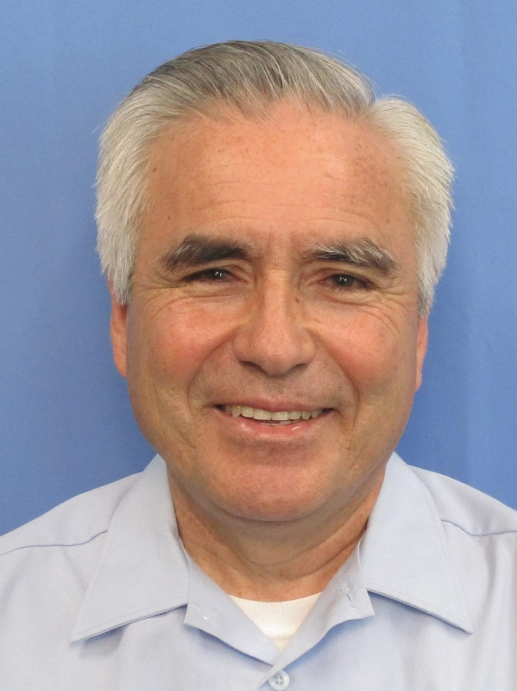
Manuel Ayala,
Bus Operator
10 Years Service Award
Manuel Ayala joined Gold Coast Transit on January 30, 2012. Before he came to Gold Coast, he worked as a bus operator at OCTA. He enjoys driving the Ojai and Saticoy routes.

Slide 4
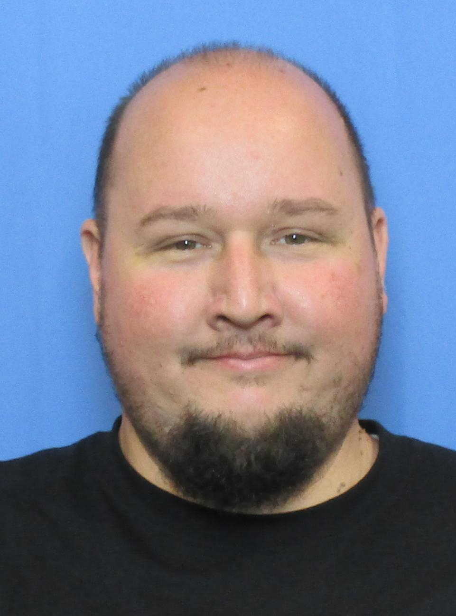
James White,
Bus Operator
10 Years Service Award
James White came from Roadrunner to join Gold Coast Transit on January 9, 2012. Since then, he has had two beautiful kids. He is a devoted husband and a father and great team player at Gold Coast Transit.

Slide 5
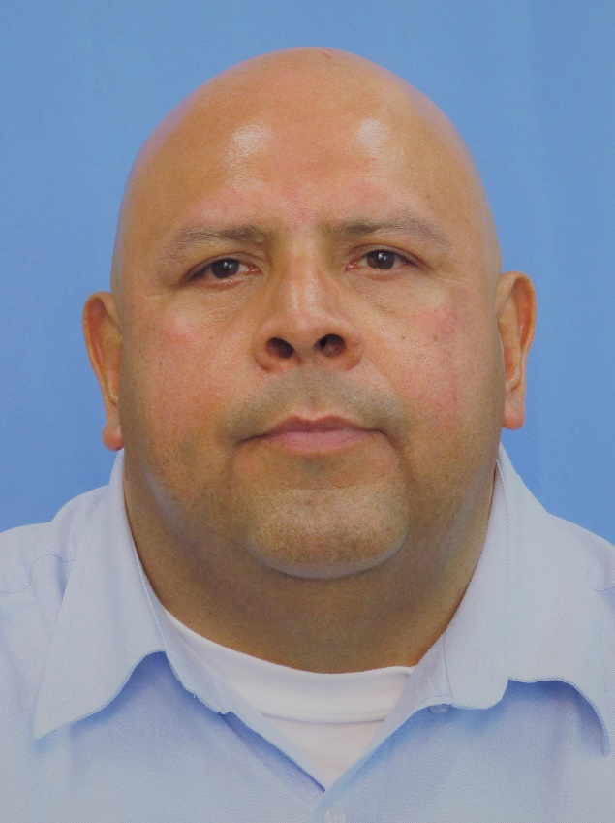
Johnny Zaragosa,
Bus Operator
10 Years Service Award
Johnny joined Gold Coast Transit on January 9, 2012. He has a brother working at GCTD also as a bus operator. Johnny enjoys cooking on his days off. He likes to share his new recipes with his colleagues.

Slide 6
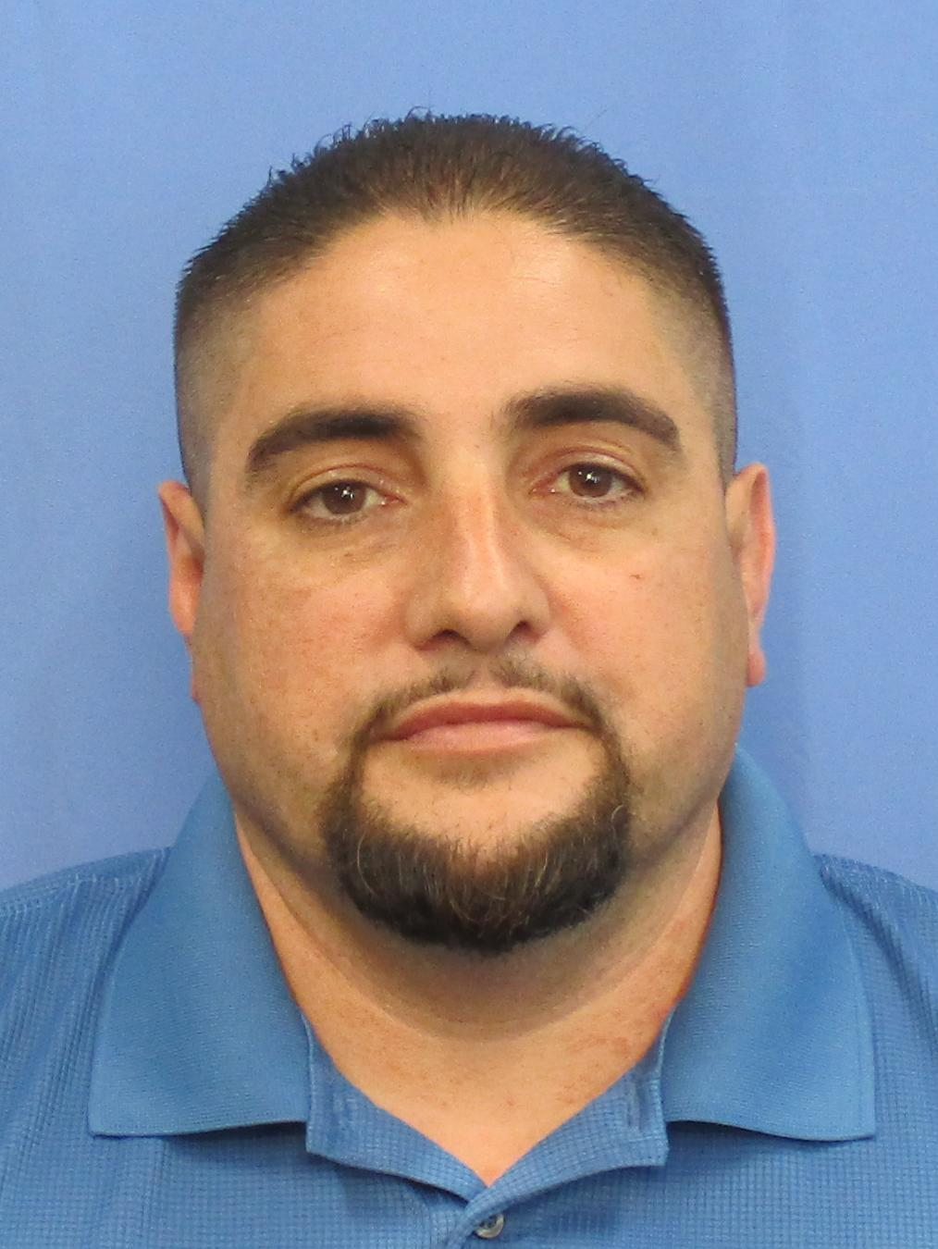
Roberto Magana,
Operations Supervisor
10 Years Service Award
Robert joined Gold Coast Transit on January 30, 2012. He has been an Operations Supervisor for 9 years. He enjoys training new drivers and working with the public.
He is a huge football fan and enjoys watching games with his daughter.
Mr. Magana would like to thank you for recognizing his 10 years with GCTD.

