Slide 1
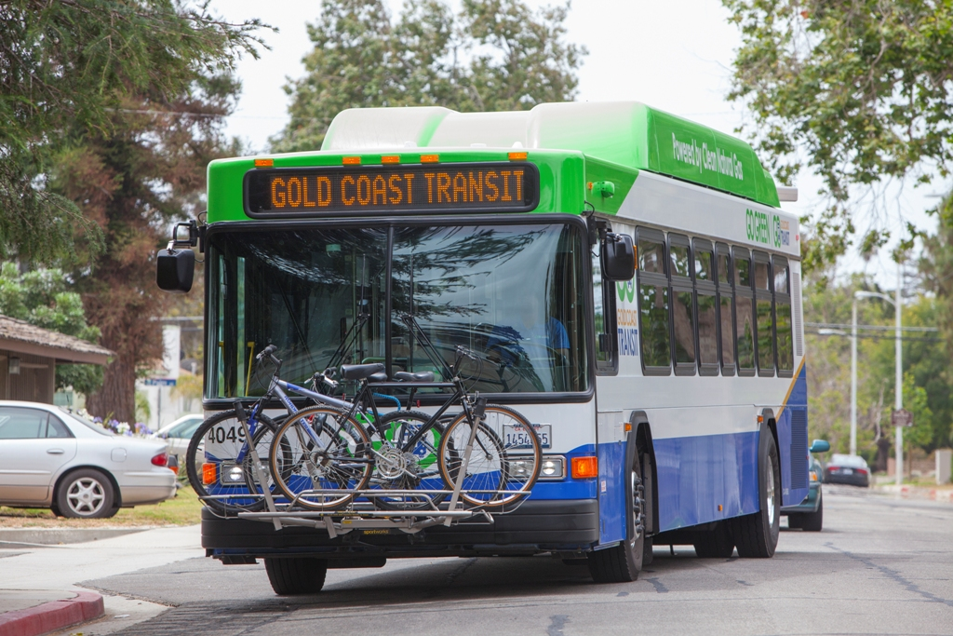
Gold Coast transit District FY21-22 state TRANSIT ASSISTANCE (STA)/state of good repair (SGR) September 1, 2021

Slide 2
FY21-22 STA/SGR FUNDING
STA FY21-22: $300,300
SGR FY21-22: $46,014

Slide 3
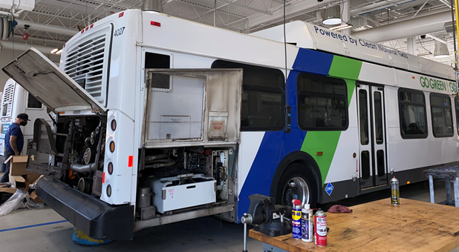
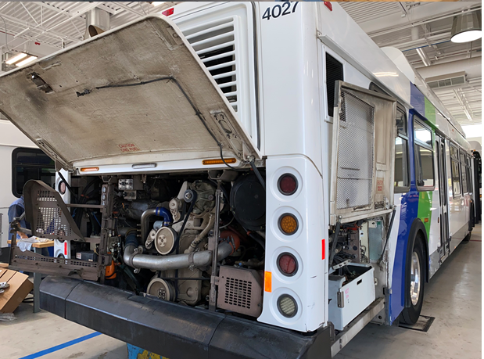
FY21-22 STA/SGR PROJECTS
NINE (9) REPLACEMENT CNG BUSES

Slide 4
FY21-22 STA/SGR PROJECT
PROJECT COST (ESTIMATED):
NINE (9) REPLACEMENT CNG BUSES $5,400,000
Note - STA/SGR funds will be used to fulfill our local match to Federal grants.

Slide 5
Questions?

